Slide 1

DATA Science Project on Banking Data
Creating a web based application, EDA, and Research about best suitable algorithm for Bank Data.

Slide 2


Presented to The Smart Bridge: Data Contribution by Kaggle.com

Slide 3
Introduction

Slide 4
Overview:
Machine Learning: The term machine learning was coined by Arthur Samuel in 1959, an American IBMer . Machine Learning is the study of computer algorithm that improves automatically through experience. Supervised [where we work towards a resultant],Unsupervised[where we work towards a unknown results] and Reinforcement[where we do trial and error].
Artificial Intelligence: Artificial Intelligence is intelligence demonstrated by machines , unlike the natural intelligence displayed by humans and animals, which involves consciousness and emotionality. It basically start from using the neural networks.

Slide 5
Purpose:
In the entire Project, the Dataset provided by Kaggle.com which is a generous bank data is used to find whether a individual person is available to get the loan or not. Using Machine Learning techniques, we build a model .
We, introduce the dataset is the model, clean the dataset and perform various Exploratory Data Analysis techniques to explore the data. Data preprocessing is used to preprocess the data and make our model simplified.
Next, we apply, compare and contrast various machine learning models.
Finally, we build the Web Application by Flask Libraries.

Slide 6
Literacy survey

Slide 7
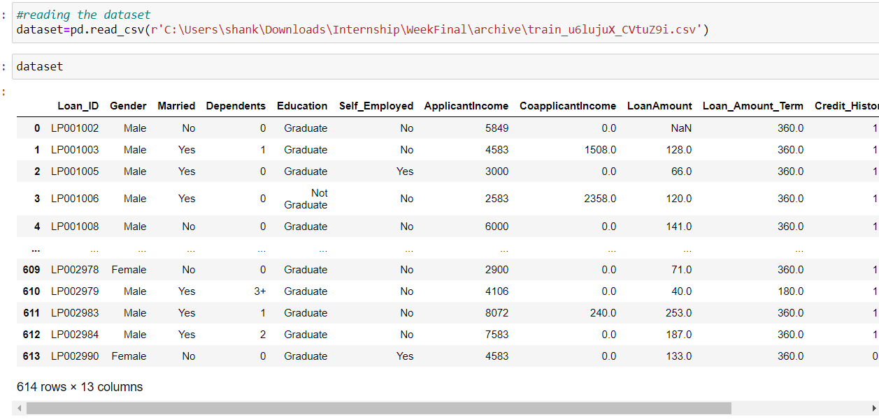
Existing Problem:

Slide 8
In the given problem , various features such as loan id, gender , married and education are given. We can view the entire dataset by first importing the dataset into the jupyter notebook, which is a web application used to code python. Next we can figure out by data set by typing the dataset name. We can also use head or tail method to take a glance at top 5 or bottom 5 data rows.

Slide 9
Purposed solution
The purposed solution is to use logistic regression which is the most generic algorithm for finding solution for bank data and then using the Spyder , the scientific python development environment to create a flask based notebook using html coding and previous jupyter notebook save file for creating web based application that refers whether a customer is loan eligible or not.

Slide 10
Theoretical analysis

Slide 11
Block diagram
Block diagram is the essential part of the project in which every horizon of the project is shown in blocks. Fundamentally, dividing the project into simpler blocks outlines the projects such that team can move from one part of project to another without much complexities. Here is the block diagram used for the project. It involves four such important blocks.

Slide 12
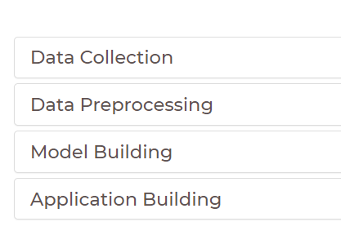
Data collection/Data preprocessing/model building and application building are the four major blocks of the project.

Slide 13
Software/hardware requirement
The majority of Project can work on Windows 10 Operating System and Mac Operating System but the vital source requirement of the project is the Anaconda Navigator, a python based platform used for data science projects, web application.
Anaconda Navigator comes with Jupyter Notebook, Spyder and most frequently used libraries.

Slide 14
Experimental Investigations

Slide 15
sklearn.metrics.accuracy_score
Sklearn which is library used for machine learning algorithm. Here use accuracy score to compare and contrast about the various machine learning algorithm and to conclude our research about best fit machine learning/deep learning algorithm for the bank data

Slide 16
Accuracy is one metric for evaluating classification models. Accuracy is percentage or fraction , our model have predicted right.
Accuracy is (Number of correct predictions) divided by (Total number of predictions).
For binary classification, accuracy can also be calculated as :
Accuracy is (TP + TN) divided by(TP + TN + FP +FN).
Where :
TP = True Positives, TN = True Negatives , FP= False Positives and
FN = False Negatives.

Slide 17
Model Name: | Accuracy_Score
Multiple Linear Regression | 0.8373983739837398
Logistic Regression | 0.8373983739837398
Support Vector Machine | 0.8292682926829268
Gaussian Naïve Bayes | 0.8373983739837398
Decision Tree Regressor | 0.6097560975609756
Random Forest Regressor | 0.6666666666666666
AdaBoost Regressor | 0.6991869918699187
Gradient Boosting Regressor | 0.6991869918699187
CatBoost Regressor | 0.7073170731707317
XGBoost | 0.7723577235772358
Lightgbm | 0.7479674796747967
Artificial Neural Network | 0.7723577235772358
Principle Component Analysis | 0.7723577235772358

Slide 18
Flowchart

Slide 19
Model Flow chart
Data Collection:
Download dataset/Create
dataset
Data Preprocessing :
Importing Libraries , Importing Dataset , Data Visualization ,
Treating Missing Value , Scaling ,Encoding , Train Test Split.
Model Building:
Training and Testing, Evaluation
Application Building:
Creating HTML file and building
Python code.

Slide 20
Results

Slide 21
The accuracy score of different models are comparable.
Support Vector Machine, Logistic Regression , Multiple Linear
Regression and Gauss Naïve Bayes are the most effective.
Banking Data among the all algorithms we found the decision tree Regression weakest and Logistic Regression , Multiple Regression and Naïve Bayes the strongest in terms of accuracy.

Slide 22
Advantages & Disadvantages :
Multiple Linear Regression , Logistic Regression and Naïve Bayes are the simplest and accurate to apply.
Decision tree and Random Forest are not the fastest and the accurate regression techniques , makes a impact on complex problems but often results in overfitting.
Boosting algorithms are their to eliminate bias and leads to good performance.
Artificial Neural Network can produce results even with incomplete information but requires certain hardware and are complex to understand.

Slide 23
Applications :
Using HTML code, machine learning and deep learning algorithms can be used to product effective web base application that takes data from the user and outputs whether the customer is available for loan processing or not.
We have used logistic regression as preferred model but considering accuracy on increasing training example, we can use Naïve Bayes as well.
The Jupyter Notebook and Spyder notebook is used along with HTML Code to produce the desired web application.

Slide 24
Conclusion:
We have successfully build model for predicting bank loan eligibility.
In the backend we have used Python Jupyter notebook, Spyder notebook and Flask Library for the essential application development.
The desired application can be used over several customer’s data where the user/operation don’t have any previous knowledge of python.

Slide 25
Future Scope
The future Scope of the Project involves : Extending the Application and designing a website based upon the generated model to calculate loan data.
We can also use multiple models at a same time used as bragging or ( Using Connective Pipelines ) to get more accuracy and easiness for our model.

Slide 26
Bibliography
First of all the produced by the team of smart bridge which selected me to be part of this internship. Next is my parents that makes me what I am Today. Nothing can happen without the Grace of God.
Thanks to Kaggle for Providing the dataset.

Slide 27
Appendix :
Source Code (attached) and UI Screen.

Slide 28
